Slide 1
REACT
Lesson 4: State Management

Slide 2

State Management
Why State Management?
State Management Libraries
Recoil
Atom
Selector

Slide 3
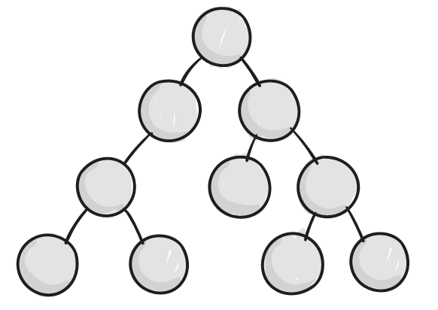


Why State Management?
Where to put application state?
In React data/functions flows in one direction from parent to child
⇨ Passing state and callbacks to children via props
⇨ This works fine, remember TODO in lesson 3
callback
props
state
props
callback
callback

Slide 4
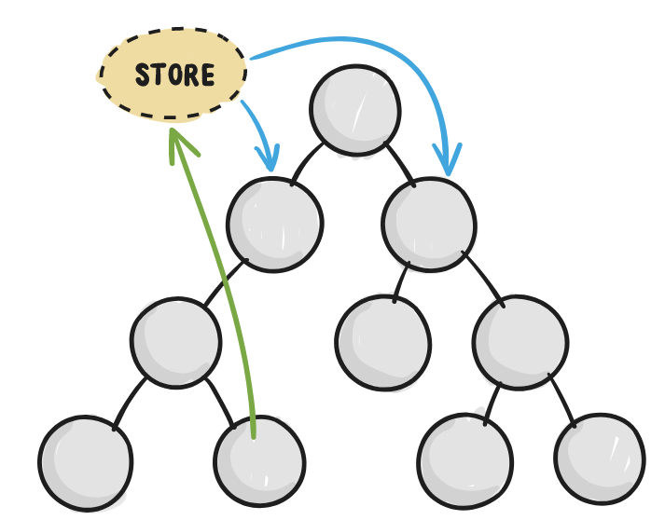
State Management
All your application state in one place, let's call it a store
Components can change the state in the store
When state is updated, each subscribed component is re-rendered with the new value
⇨ No need to pass state and callbacks to children via props

Slide 5


State Management Libraries
Redux
mostly used, but complex
Recoil
relatively new state management library for React
easy to understand for beginners and powerful features for advanced users

Slide 6
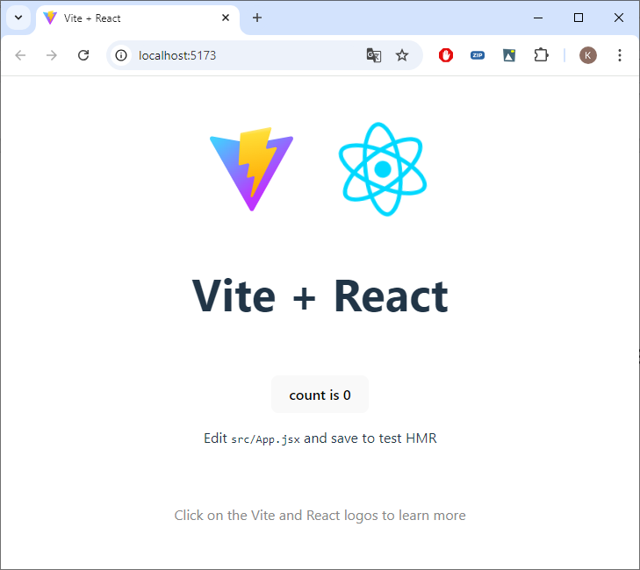
Create
npm create vite@latest lesson5 -- --template react

Slide 7
Resources
Copy
App.jsx from Resources to src
components from Resources to src

Slide 8
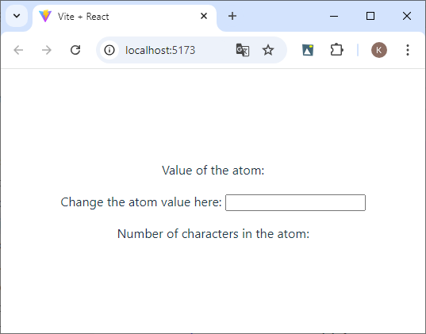
App.jsx
import './App.css';
import CharacterCounter from './components/recoil_character_counter';
function App() {
return (
<CharacterCounter />
);
}
export default App;

Slide 9
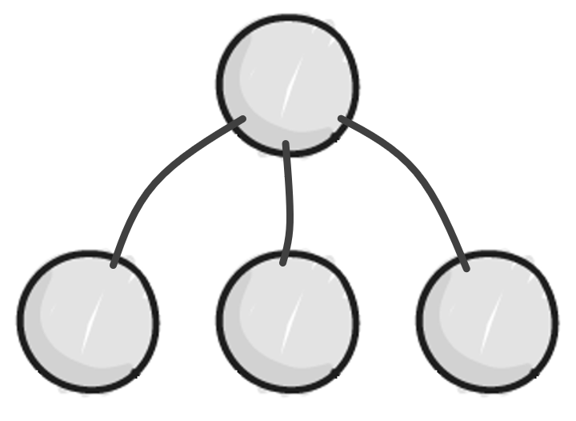
recoil_character_counter.jsx
export default function CharacterCounter() {
return (
<div>
<ValueComponent />
<UpdateComponent />
<SelectorComponent />
</div>
);
}
STORE
props
state
callback

Slide 10
Recoil
State Management Library
npm install recoil
Components that use recoil state need RecoilRoot to appear somewhere in the parent tree. A good place to put this is in your root component.

Slide 11
Atom
An atom represents a piece of state.
Atoms can be read from and written to from any component.
Components that read the value of an atom are implicitly subscribed to that atom, so any atom updates will result in a re-render of all components subscribed to that atom.

Slide 12
Create store.js
import { atom } from 'recoil';
export const textState = atom({
key: 'textState', // unique ID (with respect to other atoms/selectors)
default: 'This is a Text', // default value (aka initial value)
});
Notes:
import { atom } from 'recoil';
export const textState = atom({
key: 'textState', // unique ID (with respect to other atoms/selectors)
default: 'This is a Text', // default value (aka initial value)
});

Slide 13
Use the State Value
const [text, setText] = useRecoilState(textState);
Returns a tuple where the first element is the value of state and the second element is a setter function that will update the value of the given state when called.
This hook will subscribe the component to re-render for any changes in the requested state.
const text = useRecoilValue(textState)
Returns the value of the given Recoil state.
This hook will subscribe the component to re-render for any changes in the requested state.
const setText = useSetRecoilState(textState)
Returns a setter function for updating the value of writeable Recoil state.

Slide 14
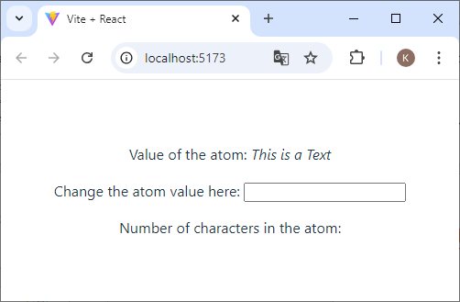
recoil_value_component.jsx
export default function ValueComponent() {
return (
<p>
Value of the atom: <i></i>
</p>
);
}
Notes:
import { useRecoilValue } from 'recoil';
import { textState } from '../store';

Slide 15
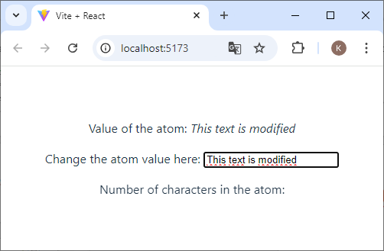
recoil_update_component.jsx
export default function UpdateComponent() {
function onChange(event) {
};
return (
<>
Change the atom value here: <input type="text" onChange={onChange} />
</>
);
}

Slide 16
Selector
A selector is a (pure) function that accepts atoms or other selectors as input and calculate derived data that is based on state.
When these upstream atoms or selectors are updated, the selector function will be re-evaluated.
Components can subscribe to selectors just like atoms and will then be re-rendered when the selectors change.

Slide 17
store.js
The get property is the function that is to be computed. It can access the value of atoms and other selectors using the get argument passed to it.
export const textSizeState = selector({
key: 'textSizeState',
get: ({ get }) => {
const text = get(textState);
return text.length;
},
});
Notes:
export const textSizeState = selector({
key: 'textSizeState',
get: ({ get }) => {
const text = get(textState);
return text.length;
},
});

Slide 18

recoil_selector_component.jsx
export default function SelectorComponent() {
return (
<p>
Number of characters in the atom: <i></i>
</p>
);
}

Slide 19
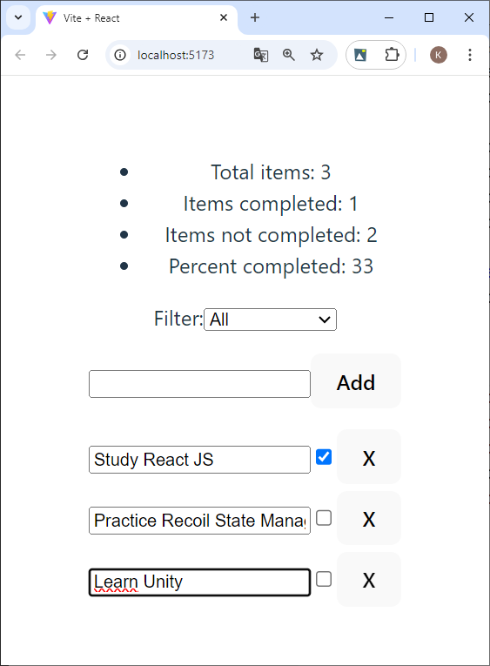
A ToDo List with Recoil
Can you find out what atoms, selectors we should have in our store?

Slide 20
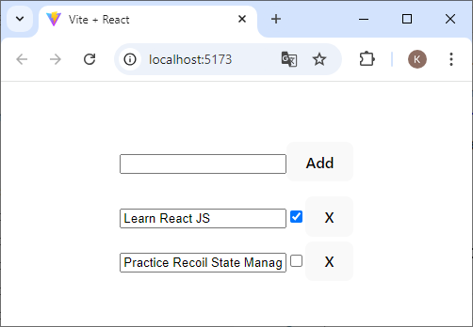
App.jsx
import './App.css';
import { RecoilRoot } from 'recoil';
import TodoList from './components/todo_list';
function App() {
return (
<RecoilRoot>
<TodoList />
</RecoilRoot>
);
}
export default App;

Slide 21
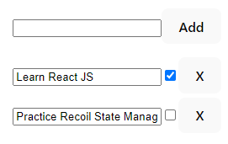
todo_list.jsx
import TodoItem from "./todo_item";
import TodoItemCreator from './todo_item_creator';
export default function TodoList() {
const todoList = [{ id: 1, text: "Learn React JS", isCompleted: true },
{ id: 2, text: "Practice Recoil State Management", isCompleted: false }];
return (
<>
<TodoItemCreator />
{todoList.map((todoItem) => (
<TodoItem key={todoItem.id} item={todoItem} />
))}
</>
);
}

Slide 22

store.js
Create the atom state in the store
Use the atom in TodoList
export const todoListState = atom({
key: "todoListState",
default: [{ id: 1, text: "Study React JS", isCompleted: true },
{ id: 2, text: "Practice Recoil State Management", isCompleted: false }]
});
Notes:
export const todoListState = atom({
key: "todoListState",
default: [{ id: 1, text: "Study React JS", isCompleted: true },
{ id: 2, text: "Practice Recoil State Management", isCompleted: false }]
});

Slide 23
todo_item_creator.jsx
You can have local state ⇨ controlled component
import { useState } from 'react';
export default function TodoItemCreator() {
const [inputValue, setInputValue] = useState('');
function addItem() {
}
function handleChange(event) {
setInputValue(event.target.value);
}
return (
<p>
<input type="text" value={inputValue} onChange={handleChange} />
<button onClick={addItem}>Add</button>
</p>
);
}

Slide 24
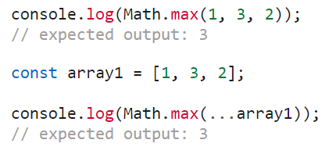
todo_item_creator.jsx (insert)
Arrays in React should be treated as immutable when you store them in state.
You also shouldn’t use methods that mutate the array, such as push() and pop().
Just like with objects, when you want to update an array stored in state, you need to create a new one (or make a copy of an existing one), and then set state to use the new array.
Notes:
function getId() {
return (todoList.length === 0) ? 1 : Math.max(...todoList.map(todo => todo.id)) + 1;
}

Slide 25
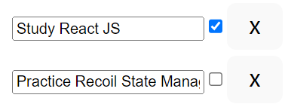
todo_item.jsx (delete, edit, toggle)
export default function TodoItem({ item }) {
function editItemText() { } function toggleItemCompletion() { } function deleteItem() { }
return (
<div>
<input type="text" value={item.text} onChange={editItemText} />
<input
type="checkbox"
checked={item.isCompleted}
onChange={toggleItemCompletion}
/>
<button onClick={deleteItem}>X</button>
</div>
);
}
Notes:
const index = todoList.findIndex((todoItem) => todoItem === item);

Slide 26
Filter our todolist
To implement a filtered todo list, we need to choose a set of filter criteria whose value can be saved in an atom.
The filter options we'll use are: Show All, Show Completed, and Show Uncompleted. The default value will be Show All
export const todoListFilterState = atom({
key: 'todoListFilterState',
default: 'Show All',
});
Notes:
export const todoListFilterState = atom({
key: 'todoListFilterState',
default: 'Show All',
});

Slide 27

Update the todoListFilterState atom
export default function TodoListFilters() {
function updateFilter(event) {
}
return (
<p>
Filter:
<select value={filter} onChange={updateFilter}>
<option value="Show All">All</option>
<option value="Show Completed">Completed</option>
<option value="Show Uncompleted">Uncompleted</option>
</select>
</p>
);
}

Slide 28
Filter the todoListState using a Selector
export const todoListFilteredState = selector({
key: 'todoListFilteredState',
get: ({ get }) => {
const filter = get(todoListFilterState);
const list = get(todoListState);
switch (filter) {
case 'Show Completed':
return list.filter((item) => item.isCompleted);
case 'Show Uncompleted':
return list.filter((item) => !item.isCompleted);
default:
return list;
}
},
});
Notes:
export const todoListFilteredState = selector({
key: 'todoListFilteredState',
get: ({ get }) => {
const filter = get(todoListFilterState);
const list = get(todoListState);
switch (filter) {
case 'Show Completed':
return list.filter((item) => item.isCompleted);
case 'Show Uncompleted':
return list.filter((item) => !item.isCompleted);
default:
return list;
}
},
});

Slide 29
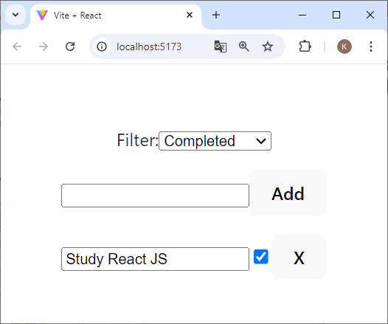
Add the Filter to TodoList
Show the component to select a filter
Use the filtered list

Slide 30
The Final Touch, let's add some stats
export const todoListStatsState = selector({
key: 'todoListStatsState',
get: ({ get }) => {
const todoList = get(todoListState);
const totalNum = todoList.length;
const totalCompletedNum = todoList.filter((item) => item.isCompleted).length;
const totalUncompletedNum = totalNum - totalCompletedNum;
const percentCompleted = Math.round(totalNum === 0 ? 0 : totalCompletedNum / totalNum * 100);
return {
totalNum,
totalCompletedNum,
totalUncompletedNum,
percentCompleted,
};
},
});
Notes:
export const todoListStatsState = selector({
key: 'todoListStatsState',
get: ({ get }) => {
const todoList = get(todoListState);
const totalNum = todoList.length;
const totalCompletedNum = todoList.filter((item) => item.isCompleted).length;
const totalUncompletedNum = totalNum - totalCompletedNum;
const percentCompleted = Math.round(totalNum === 0 ? 0 : totalCompletedNum / totalNum * 100);
return {
totalNum,
totalCompletedNum,
totalUncompletedNum,
percentCompleted,
};
},
});

Slide 31
Complete todo_list_stats.jsx
export default function TodoListStats() {
return (
<ul>
<li>Total items: </li>
<li>Items completed: </li>
<li>Items not completed: </li>
<li>Percent completed: </li>
</ul>
);
}

Slide 32
Our Final todolist
Add the stats at the top of the page

Slide 33
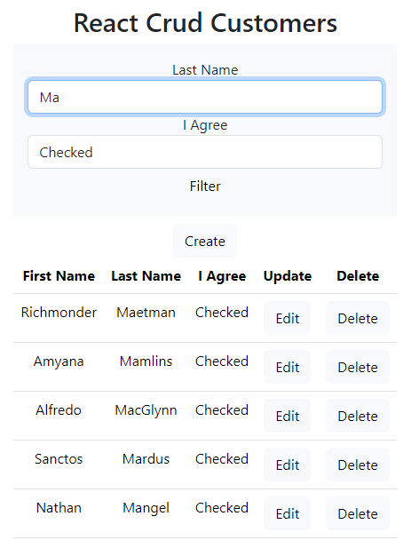
Exercise
Modify the crud-customers program from lesson 4. Make sure you can filter the customers by the beginning of the last name and the value of iAgree.
Put the filters in the application state (= store).
The filtering of the customers is done client-side because it cannot be done via mockapi. You can use the getCustomers method for that.
Normally you would obviously do something like this server-side.

